Slide 1


Using EE for SEO
Valerie DiCarlo and Jeremy Gimbel

Slide 2
Who are we?
Valerie DiCarlo
SEO Web Consulting
www.seo-web-consulting.com
@vdcseo
Jeremy Gimbel
Conflux Group
confluxgroup.com
@dreadfullyposh

Slide 3

WHEN IS IT TIME?
Before a site build/redesign?
YES
During a site build/redesign?
YES
After a site build/redesign?
YES

Slide 4

WHAT’S BEFORE?
Selecting a flexible, customizable, search-engine friendly PLATFORM
Intuitive, independent SEO functionality
URL structure
Mobile friendliness
Ease and customized UI (for client)
Keyword Research to wireframe an optimized site DESIGN ARCHITECTURE
Navigation, menus, breadcrumbs
Customized positioning of H1 headlines
Customized positioning of H2’s and H3’s

Slide 5

WHAT’S DURING?
Implementing best practice SEO elements in site DEVELOPMENT
URL structure
Mobile friendliness / AMP (accelerated mobile pages)
Social optimization / integration
Open graph, Twitter cards, etc.
Site speed
Rich snippets/structured data/schema
Customized/dynamic XML sitemap
Robots.txt (and disallowing dev/staging environment)
Redirects
Conversion optimization (lead gen forms, shopping cart, etc.)
Tracking
Implementing best practice SEO in site CONTENT
On-page optimization
Metas
Use and positioning of Header headlines (H1, H2)
Image optimization
Blog optimization (categories, tags, pagination)

Slide 6

WHAT’S AFTER?
Ongoing Marketing, Tracking & Measuring
Optimized content development strategy
Content marketing strategy (e.g. social amplification, industry publicity, guest blogging, etc.)
Web analytics for monitoring and measuring
Tweak, Rinse, and Repeat
Other considerations
Local SEO (onsite (schema) as well as Google My Business, Bing Places for Business, local directories, reviews)
Social optimization (onsite (structured data) as well as optimizing all social channels)

Slide 7
And now for something a little more nerdy.

Slide 8
Keeping Your SEO Consultant Happy
The key to keeping your SEO Consultant and clients happy is finding a balance between customization and automation.
Basic field setup
Custom URLs for optimization
Editable robots.txt
Automate sitemap.xml
Client-editable redirects
Use an SEO-ready layout
Put it all together with templates

Slide 9
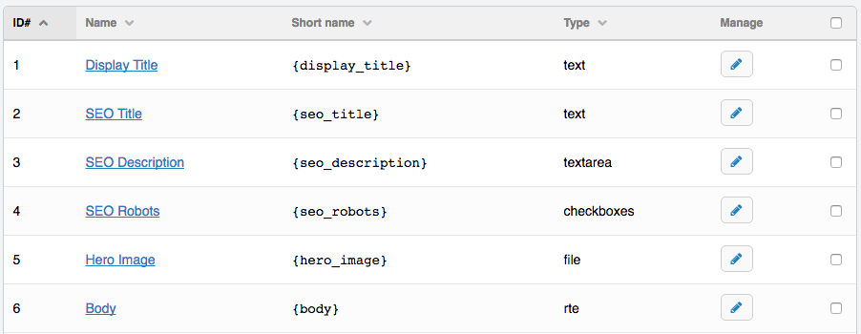
Field Setup
A standard set of fields to start any channel.

Slide 10
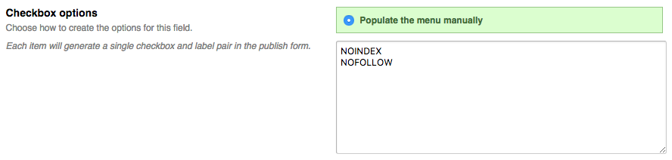
Field Setup: Meta Robots
Setup checkboxes for NOINDEX and NOFOLLOW.

Slide 11
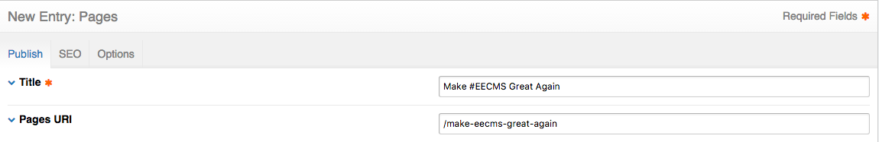
Optimizable URLs
Use the first party Pages module, or Construct, or Structure to manage stand-alone content pages.

Slide 12
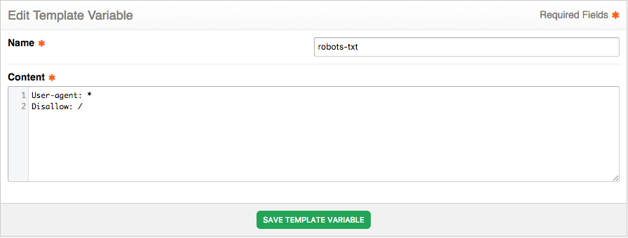
Editable robots.txt
Setup a template variable to store your robots.txt content

Slide 13
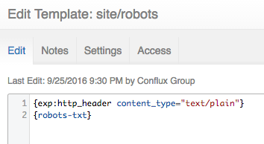
Editable robots.txt
Build a simple template to output the template variable. I named it robots.html.
Use HTTP Header (github.com/rsanchez/http_header) to force the template to output as plaintext.

Slide 14

Editable robots.txt
Add a template route to route /robots.txt to the robots.html template.

Slide 15
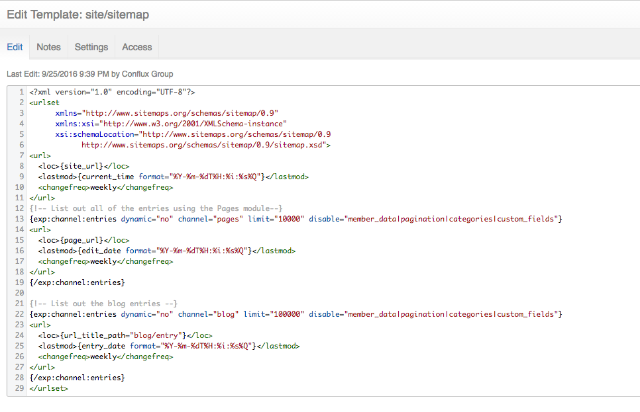
Automate sitemap.xml
Build a template to output the entries from each channel. I named the template sitemap.xml

Slide 16
Automate sitemap.xml
Similar to what we did with robots.txt, add a route for the sitemap as well.

Slide 17
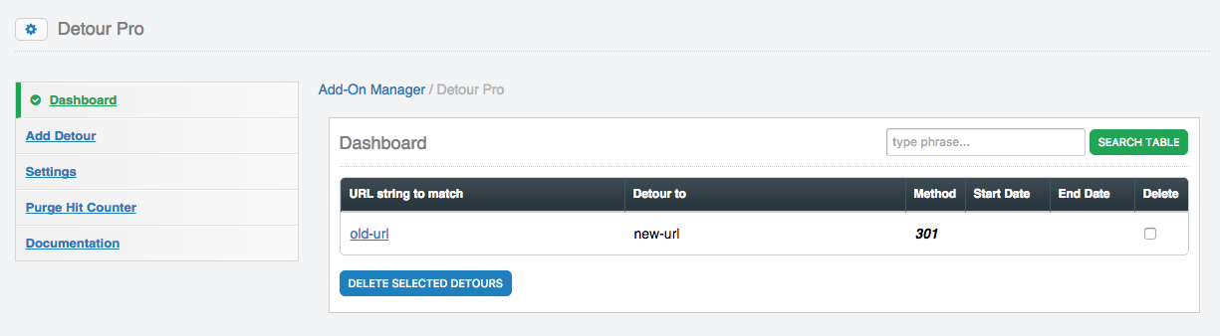
Client-editable Redirects
.htaccess redirects are a drag and not very easy for clients to use. Use an add-on like Detour Pro

Slide 18
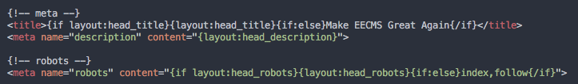
SEO-ready Layout
Use layout variables to set the title, description and the robots meta tag.

Slide 19
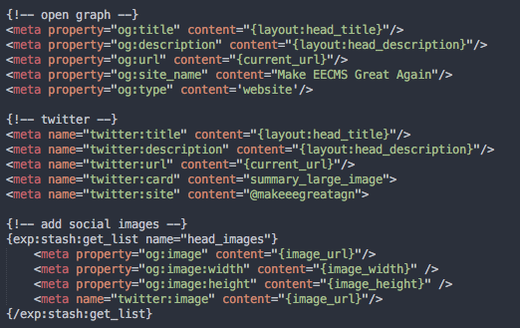
SEO-ready Layout
And while we’re at it, we’ll use the same fields to add social network meta tags too.
I still use Stash for the social images, because a template might need to send more than one
Image to the layout, and unfortunately layout variables don’t support lists yet.

Slide 20
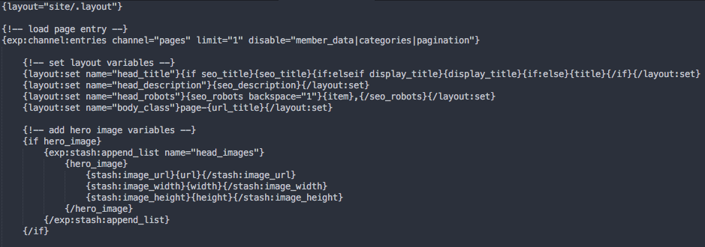
Templates
At the top of the template, set all of the variables that the layout needs.
For the title, use a conditional to allow for a sensible fallback value.
Use Stash lists to add any images in image fields to the list for social image meta tags.

Slide 21
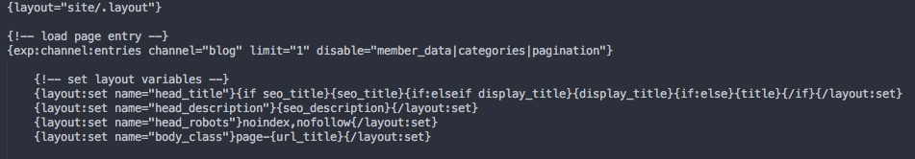
Templates (continued)
For some templates, such as categories or pagination, you’ll want to hard code the robots values, to prevent clients from messing with the settings.

Slide 22
Other Ways to Optimize
Page load speed is starting to greatly impact search rank. Remember to minimize embeds and use disable parameters on your channel:entries tags religiously.
Build everything mobile-friendly.
Include JSON-LD schema data when possible. You can re-use many of the same template variables (and add additional variables) to help with this.

Slide 23
More Resources
These techniques are used on a working demo site
MakeEECMSGreatAgain.com
or download the files at
github.com/ConfluxGroup/make-eecms-great-again

Slide 24
Who are we?
Valerie DiCarlo
SEO Web Consulting
www.seo-web-consulting.com
@vdcseo
Jeremy Gimbel
Conflux Group
confluxgroup.com
@dreadfullyposh

